Slide 1
Humor detection
for Mandarin
EECS 487
final presentation
Sida Zhong, Zhong Zheng, Vijay Sharma
Notes:
1-8 Star

Slide 2
TABLE OF CONTENTS
1.
4.
2.
5.
3.
6.
WHY HUMOR IN MANDARIN?
APPROACH & IMPLEMENTATION
What is the problem we were solving?
Our methodology for attempting to solve the problem
TASK DESCRIPTION
RESULTS
What is our task?
The main experimental results
PAST WORK
CONCLUSION
How have people tried to solve this problem before?
What did we learn?
Notes:
Four parts:
Why
What
Past
Ours

Slide 3
WHY HUMOR IN MANDARIN?

Slide 4
IMPORTANCE
Utility
Wide application
Equity
Understanding natural language requires understanding humor
Provide better user experience on Virtual Assistants and Chatbots, such as Siri, Amazon Alexa, etc.
Bring developments from NLP research in English to other languages

Slide 5
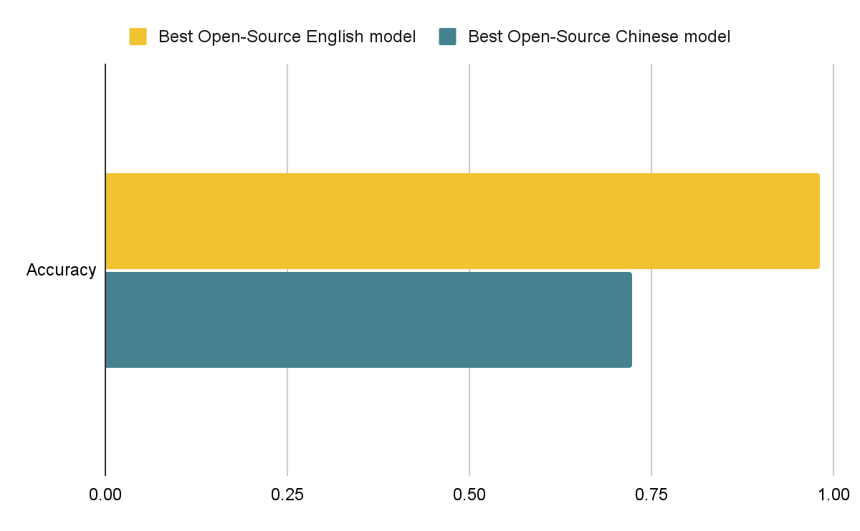
WHY HUMOR IN MANDARIN?
English model performs better at classifying humorous text
Fewer high-performing published Mandarin models
Goal: We analyze previous humor detection models and build new models to achieve better performance on Mandarin humor detection.

Slide 6
TASK DESCRIPTION
Notes:
6-8 Star

Slide 7

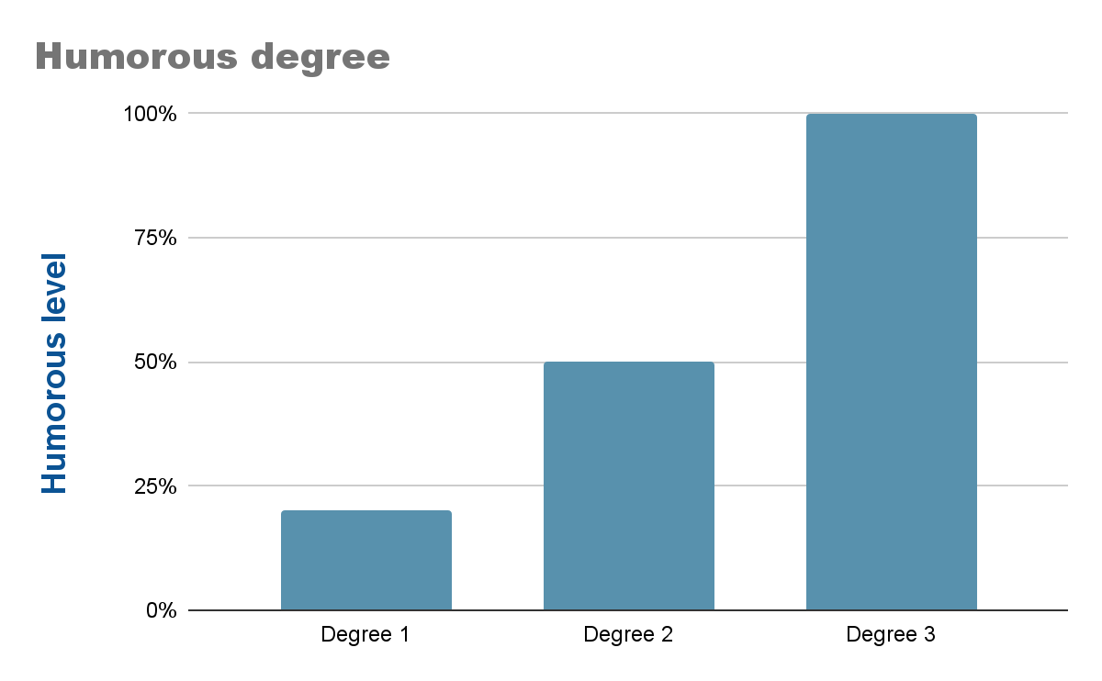
Task Description
Task 1:
Binary task: Given a Mandarin text, tell whether it is humorous or not.
Task 2:
Ternary task: Given a Mandarin joke, detect if it is weakly funny, somewhat funny, or very funny.
😹
😬
🙂
Notes:
/ˈtərnərē/
From now on we will refer to them as Task 1 and Task 2

Slide 8
Dataset Description
Each data contains three part:
Data_id: the id of the text
Text: the text for model to learn
Label: is it a funny joke or not or how funny it is?
Task 1: 0, 1
Task 2: 0, 1, 2
Data_id | Text | Label
1 | 长寿秘诀:保持呼吸，不要断气。 | 1
2 | 计算机科学是一门非常重要的学科。 | 0
Dataset preprocessing:
Original size:
Task 1: 11,356 as label 1, 4844 as label 0
Task 2: 3638 as label 2, 4408 as label 1, 8624 as label 0
Rebalance:
Task 1: 8000 for training, 1600 for testing
Task 2: 9000 for training, 1800 for testing

Slide 9
PAST WORK
Notes:
9-13 Vijay

Slide 10
Past Work
Use standard word embeddings and LSTM to classify Mandarin text
Binary classification accuracy (Chinese): 0.723
LSTM on Mandarin
Use BERT sentence embeddings and a feed forward neural network to classify English text
Binary classification accuracy (English): 0.982
ColBERT on English

Slide 11
Highest Performance
Unpublished models by 清博AI have the highest performance on Task 1 and Task 2 from a competition.
Task 1: 0.9488 F1-score
Task 2: 0.5011 F1-score
We aim to achieve comparable or better performance and share our results.

Slide 12
APPROACH & IMPLEMENTATION

Slide 13
What did we try?
Use Google translation API to translate text to English
Put the translated text into model
Task 1 accuracy: 0.771
ColBERT on Translated Chinese text
Use BERT embeddings and a neural network to classify text
Task 1 accuracy: 0.783
ColBERT on Chinese Text
simpletransformers library text classifier using BERT
Task 1 accuracy 0.813
Task 2 accuracy: 0.482
BERT simpletransformers classifier
Notes:
Don’t need to talk about on the first two accuracy, just briefly mention or skip

Slide 14
Best Model
BERT
features
LSTM
Best Model
Macro F1 Score:
0.832 on Task 1
0.521 on Task 2
Data preprocess
Loss Function
BERT model + selected features + LSTM
Training
Testing
Notes:
14-18 Lawrence
Our best model consists of a Bert encoder, custom selected features, and LSTM layers

Slide 15
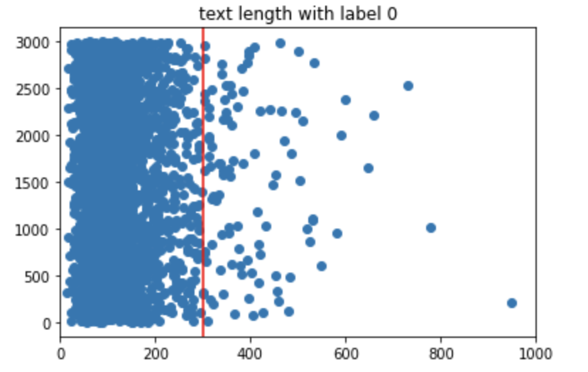
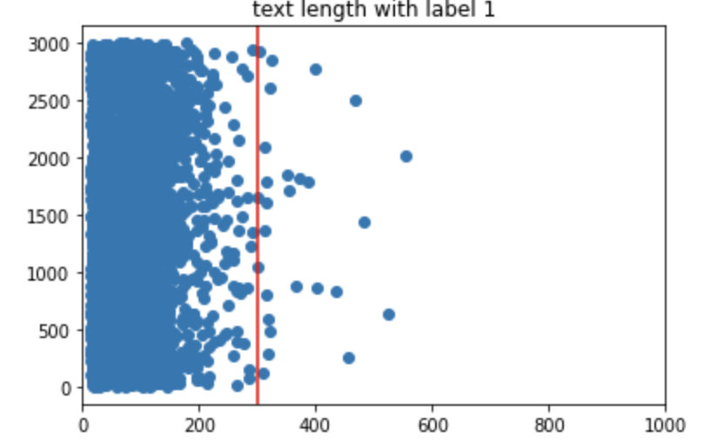
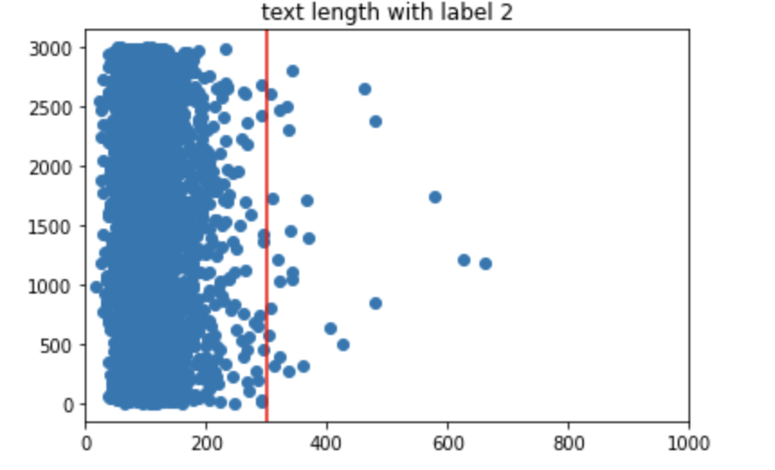
Feature Selection
Punctuation
Colon(：)
Question mark (？)
exclamation mark (！)
Chinese text comma(、)
Text length
Special groups
dad/mom（爸/妈）
wife/husband（妻子/丈夫）
doctor/patient（医生/病人）
attorney/prionsor （律师/犯人）
Notes:
{0: 290 1: 1809}
We explore our dataset to see what makes a text humorous. Here is what we find. First, punctuation is a good indicator of humor. When language is stated in some special form, such as dialog and questions, they are more likely to be humorous. Therefore, punctuation is a good indicator of such information. Also, text length makes a difference. We plot the distribution of the text length with respect to the label. Different labels have different text length. Therefore, we also need to encode such information. Finally, the humor are related to some special groups. When some special groups such as dad/mom, husband and wife are mentioned, it is more likely to be humorous. For each features, we use a single indicator bit in the embeddings to encode them in the model.

Slide 16
Model Structure
Input
Model
Output
BERT Encoder
Embeddings
(768 dimensions)
LSTM
FC-Layers
& Softmax
Text
Selected Features
(6 dimensions)

Slide 17
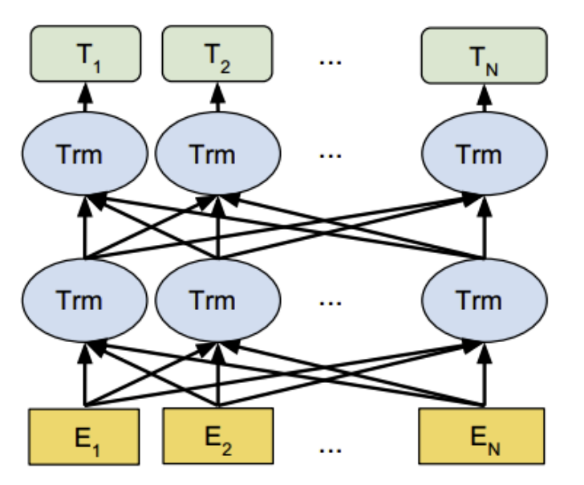
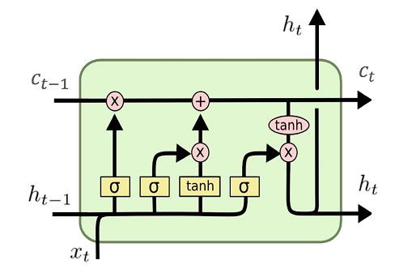
Input
Model
Output
BERT Encoder
Embeddings
(768 dimensions)
FC-Layers
& Softmax
Bert Encoder
Selected Features
(6 dimensions)
LSTM
Text

Slide 18
Input
Model
Output
Embeddings
(768 dimensions)
FC-Layers
& Softmax
Bert Encoder
Selected Features
(6 dimensions)
LSTM
Text

Slide 19
RESULTS
Notes:
17-18 Star

Slide 20
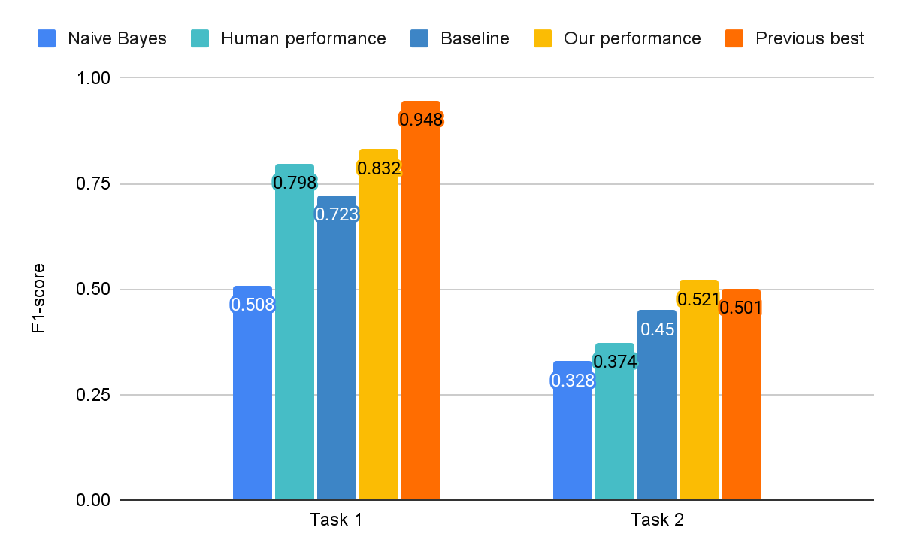
Result compare
Baseline:
Task 1: Open Source Chinese LSTM
Task 2: Median score in competition
Hyperparameters
Learning rate: 1e-6
Batch Size: 2
Loss: Cross Entropy
Weight Decay: 1e-4
Notes:
Hyperparameter
Task1 and Task2
Outperform best on Task2
Hand labeled 600 samples for each task.

Slide 21
CONCLUSION
Notes:
19-end Vijay

Slide 22
What we learned
It is not trivial to apply NLP methods from one language and apply them to another
Due to the ambiguous nature of humor, it is difficult for both humans and machines to quantify
Open source datasets and models are key to improving NLP models as a community

Slide 23

FUTURE CHALLENGES
---- Can we do better?
Better ways to encode custom features
Loss function improvement
Larger Corpus
Better ways to evaluate sense of humor

Slide 24
Reference
[1] DUTIR-Emotion-Group. 2019. Dutir-emotion-group/CCL2019-chinese-humor-computation: CCL2019，"小牛杯"中文幽默计算任务的数据集及baseline. (October 2019). Retrieved April 1, 2022 from https://github.com/DUTIR-Emotion-Group/CCL2019-Chinese-Humor-Computation
[2] Huanyong Liu. 2018. Chinese Humor Sentiment. (December 2018). Retrieved February 14, 2022 from https://gitcode.net/mirrors/liuhuanyong/ChineseHumorSentiment?utm_source=csdn_github_accelerator
[3]Moradnejad. 2021. Moradnejad/colbert-using-bert-sentence-embedding-for-humor-detection: Novel model and dataset for the task of humor detection. (April 2021). Retrieved April 1, 2022 from https://github.com/Moradnejad/ColBERT-Using-BERT-Sentence-Embedding-for-Humor-Detection

Slide 25
THANKS!

